Slide 1








K-Bliver: Utilization of K-means Clustering in Liver Ailment Detection
Group 3: Cacal, Chad R. | Dela Cruz, Alfonso Rafael C. | Palabay, Joven Carl B. | Suyu, Chester T.

Slide 2
I ntroduction
Image segmentation is essential in computer vision, dividing an image into distinct, analyzable regions. It is crucial for applications like medical imaging, object detection, and image editing. K-means clustering is a common method for segmentation, grouping data into clusters based on similarity. Users specify the number of clusters (K), and the algorithm categorizes the data so that intra-cluster similarity is high and inter-cluster similarity is low (Wu, 2021). This makes K-means effective for segmenting images based on pixel intensities and colors.
Although K-means clustering is effective, it can be computationally intensive, especially with high-resolution medical images. The iterative data assignment and centroid recalculation processes require significant resources. Recent advancements use Graphics Processing Units (GPUs) to speed up K-means clustering. By leveraging the Compute Unified Device Architecture (CUDA), segmentation becomes more efficient, enabling faster analysis of large medical datasets and improving diagnostic workflows. This GPU-based approach breaks down the problem into sub-problems processed independently on Streaming Multiprocessors (SMs) of GPUs, resulting in quicker and more efficient image segmentation (Fakhi et al., 2017).
K-means clustering is widely used for segmenting liver images in medical imaging. It groups image data into clusters based on similarity, helping distinguish between healthy and diseased liver tissue. This technique is effective in identifying abnormalities like tumors or fibrosis. Accurate image segmentation supports better diagnosis, treatment planning, and monitoring of liver diseases.

Slide 3



Objectives
This project aims to implement liver image segmentation using K-means clustering in Python, exploring both traditional CPU-based methods and modern GPU-accelerated techniques. The goal is to provide a comprehensive understanding of how K-means clustering can be utilized for medical image segmentation and to demonstrate its practical application with a focus on optimizing performance.
In this project, we will utilize Python and various image processing libraries to implement a system that performs the following:
Understand the Role of K-means Clustering in Liver Image Segmentation:
Investigate how K-means clustering segments liver images based on pixel similarity, enhancing the analysis of liver ailments.
Analyze the Effectiveness of K-means Clustering for Liver Image Types:
Evaluate the performance of K-means clustering across various liver image types, assessing its strengths and limitations in detecting different tissue textures and abnormalities.
Compare K-means Clustering with Other Medical Image Segmentation Techniques:
Conduct a comparative analysis of K-means clustering and alternative methods like Gaussian Mixture Models (GMM) or Mean Shift to assess the relative effectiveness of K-means in medical imaging.
Evaluate the Computational Efficiency of K-means Clustering in Liver Image Segmentation:
Measure the computational requirements and performance bottlenecks of K-means clustering in the context of liver image segmentation, identifying opportunities for optimization in real-world clinical applications.

Slide 4




Review of Related Literature
K-means in Image Segmentation
K-means clustering is a popular method for grouping data, widely used in image segmentation. Wu (2021) highlights its effectiveness in categorizing image pixels into clusters based on similarity, making it ideal for segmenting images into meaningful regions by minimizing intra-cluster variance and maximizing inter-cluster variance.

Slide 5



Review of Related Literature
GPU-Accelerated K-means Clustering
K-means clustering is effective but computationally demanding, especially with high-resolution images. Fakhi et al. (2017) address this by proposing a GPU-based implementation to speed up the process. By offloading data assignment and centroid recalculation to GPUs and utilizing CUDA for parallel processing, their method significantly reduces computation time. This approach is especially beneficial for large-scale image segmentation tasks.

Slide 6



Review of Related Literature
Enhanced Clustering Techniques
Pandey and Sharma (2023) highlight the impact of clustering algorithms on improving learning experiences in blended-learning environments. While focused on education, their research underscores the importance of optimizing clustering techniques for better outcomes. This conceptual framework is applicable to fields like image segmentation, where refining algorithms like K-means is crucial for success in specific applications.

Slide 7
Review of Related Literature
Liver disease detection using machine learning methods
Chronic liver disease, caused by factors like undiagnosed hepatitis and excessive alcohol use, is a major global health issue. Early detection is crucial but challenging. This study uses AI to improve liver disease forecasting through a two-step approach: predicting disease presence with supervised learning algorithms and assessing severity with K-Means Clustering. The study evaluates methods using metrics like Precision, Recall, Accuracy, and ROC-AUC, aiming to advance ML/DL approaches for liver disease prediction.

Slide 8
Methodology
The Python code development for image segmentation using K-means clustering will follow an Agile methodology with several focused sprints. It begins with setting up the environment and implementing the basic algorithm, followed by testing on a simple image. The project will then integrate preprocessing steps like resizing and normalization to enhance segmentation, refine cluster initialization, and test the impact of these techniques.

Slide 9



Methodology
Next, GPU acceleration using CUDA will be implemented to optimize performance, with a comparative analysis between CPU and GPU versions. The project will undergo extensive testing on diverse images, refining the code for robustness. Finally, comprehensive documentation and a summary report will be prepared, ensuring the solution is well-documented and efficient.

Slide 10
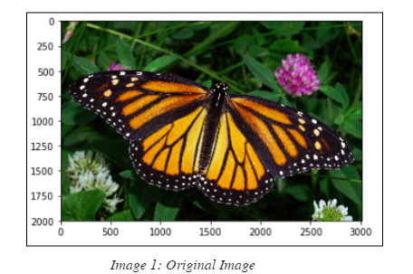
Image Segmentation with K-means Clustering
Image 1 represents the input: a high-resolution photograph of a butterfly resting on a flower amidst a background of green foliage. This image contains a rich variety of colors and textures, including the bright orange and black of the butterfly's wings, the green leaves, and the colorful flowers.

Slide 11
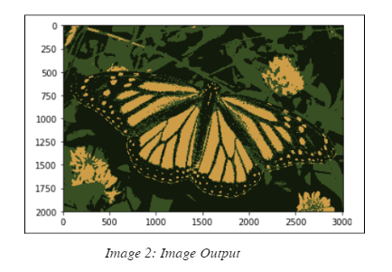
Image Segmentation with K-means Clustering
Image 2 shows the result of K-means clustering, reducing the original colors to a few clusters. The butterfly's wings and background are simplified into distinct color regions, highlighting the butterfly and making the image easier to analyze.

Slide 12
Image Segmentation with K-means Clustering
K-means clustering segments an image by grouping pixels into clusters based on color similarity, with each pixel assigned to the closest mean color value. The number of clusters (K) is set beforehand, and the algorithm iterates until the clusters stabilize. In this example, K-means simplifies the image by grouping similar colors, resulting in distinct regions for the butterfly and background. This transformation aids in applications like object recognition by making specific regions easier to analyze.

Slide 13




Thank you!
Group 3: Cacal, Chad R. | Dela Cruz, Alfonso Rafael C. | Palabay, Joven Carl B. | Suyu, Chester T.

